Slide 1
Percentage in daily life
Made by: Iva, 8th grade
Mentored by: Marijana Pili, Math teacher
Elementary School Pušća, Croatia

Slide 2
What is the percentage?
The term percentage is a fraction with a denominator of 100
$$p\%=\frac{p}{100}$$
Percentage in mathematics is very important to master well because we will need to calculate something with percentage in life.

Slide 3
Where we all use percentage?
percentages are found in:
shop
medicine
sports
betting
on tests
diet

Slide 4
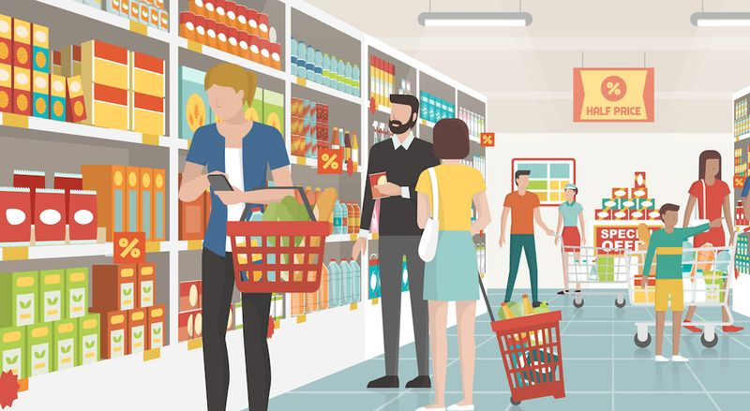
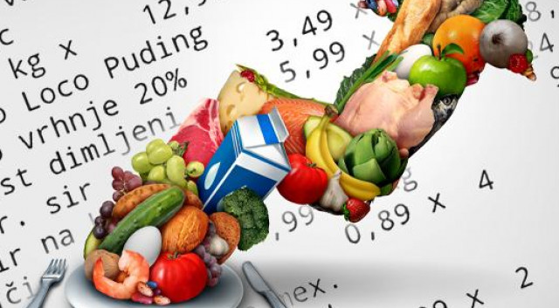
Percentage in shop
lowering prices
raising prices

Slide 5
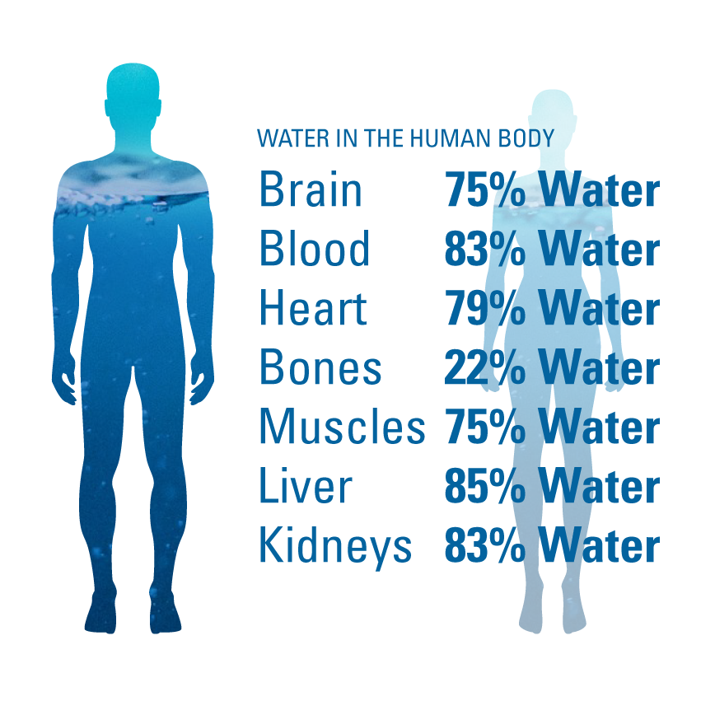
Percentage in medicine
making medicines
when making medicines, the percentage of a certain content of a substance is important
the percentage of water in the body
the percentage of red and white blood cells in the blood

Slide 6
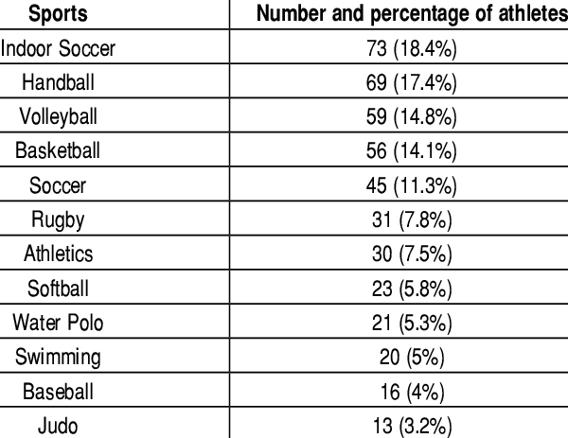
Percentage in sports
popularity of the sport
the percentage of people who practice the sport
Percentage of results, wins and losses

Slide 7
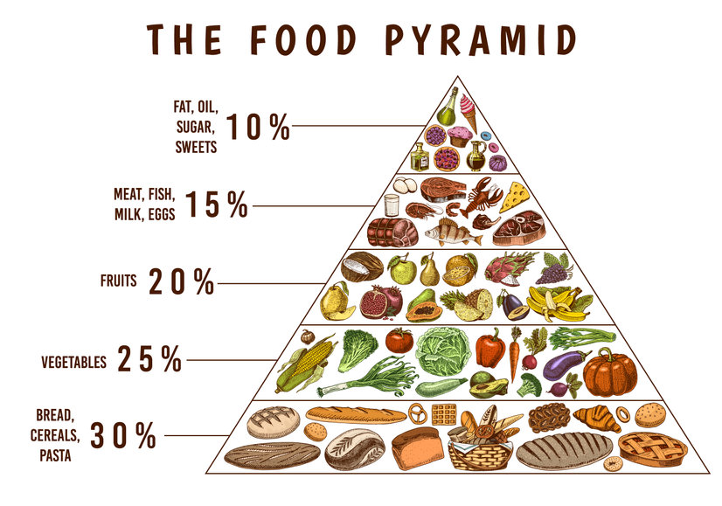
Percentage in the diet
intake of healthy foods
protein and carbohydrate intake
water intake

Slide 8
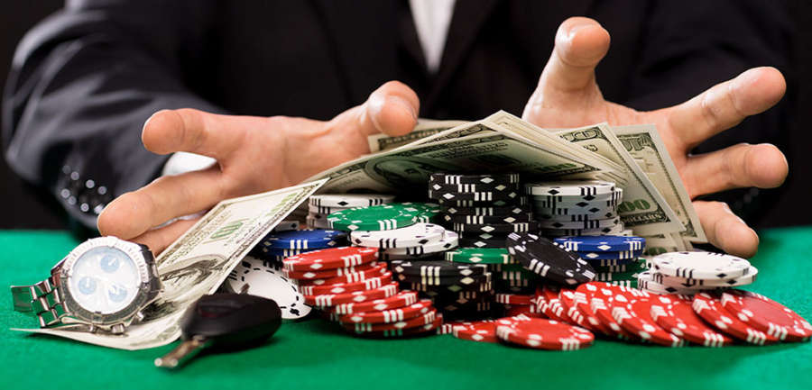
Percentage in betting
money gained and lost
percentage of happiness
percentage of correct and incorrect answers

Slide 9
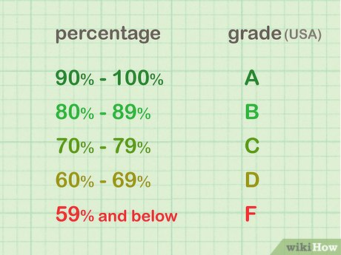
Percentage on test
percentage of correct answers
percentage of incorrect answers
average grade of the whole class in percentage

Slide 10
Thank you for your attention! ☺

Slide 11
Literature
https://en.wikipedia.org/wiki/Percentage
https://www.mathgoodies.com/Webquests/Percent_Daily_Life
https://qrfellows.wordpress.com/2013/11/18/everyday-uses-of-percentages/

