Slide 1
NATIVE FOOD IN THE FORMS OF GEOMETRIC BODIES

Slide 2
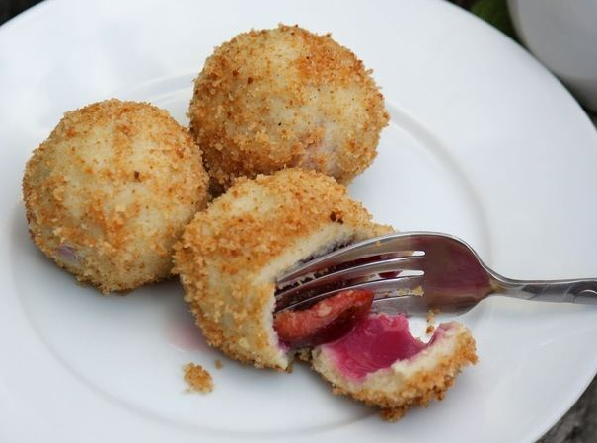
KNEDLE
knedle is a dish of boiled potato-dough dumplings, less often from cottage cheese or steamed dough filled with plums or apricots
originating from the Austro-Hungarian Empire
popular in Central and East European countries, the dish is eaten as dessert, a main dish, or side dish
they are spherical in shape

Slide 3
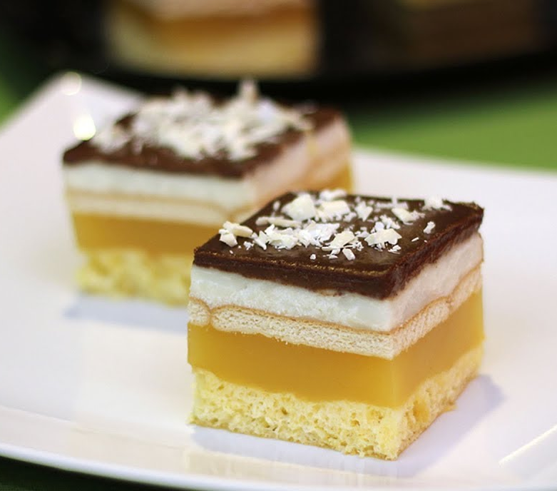
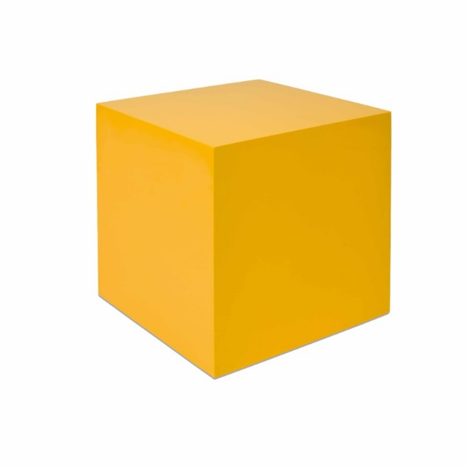
ZAGORSKE KOCKE (LAMBADA KOCKE)
Lambada cubes are named after a popular song and dance from the 1980s
it consists of several layers; for starters, there is a fine and soft biscuit on which we put a refreshing orange-flavored fruit cream, on top of the fruit layer we placed Petit Beurre biscuits soaked in milk, and put on them a delicious white vanilla cream
they can be in the shape of a cube

Slide 4
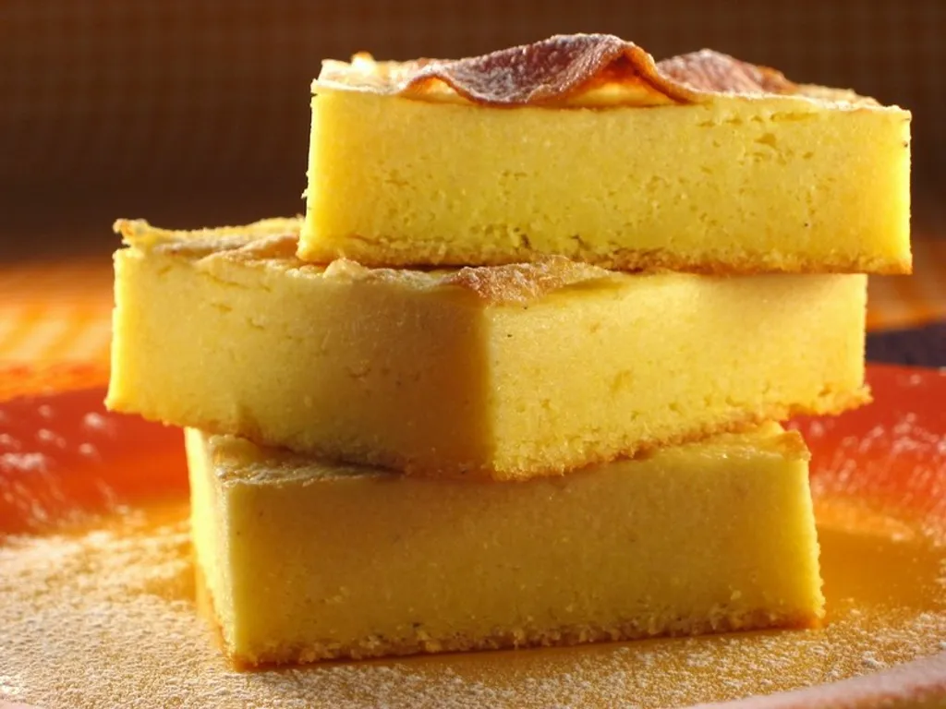
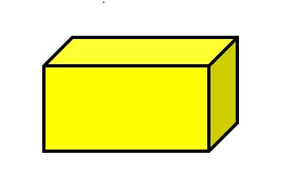
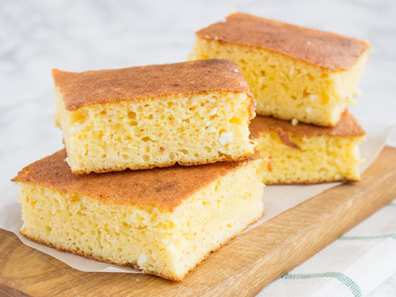
KUKURUZNA ZLEVANKA
served warm or cold – as a side dish, as a main course, as a breakfast, as a substitute for bread or pastries
the abundance of protein guarantees satiety and a strong foamy structure of the dough, and in addition to the dough itself, you can serve it with spreads or meat slices, fruit or jams
shape of a rectangular prism

Slide 5
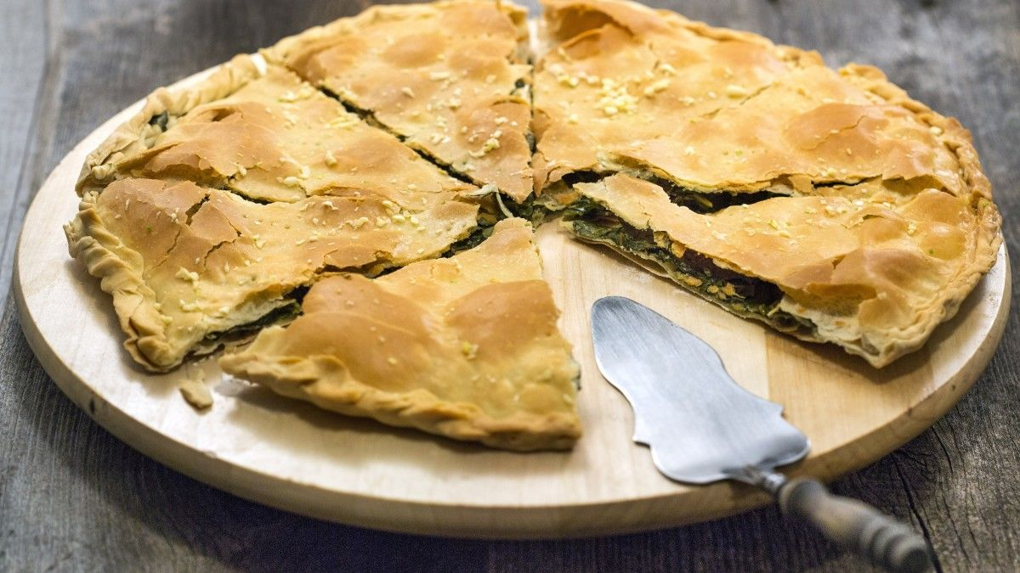
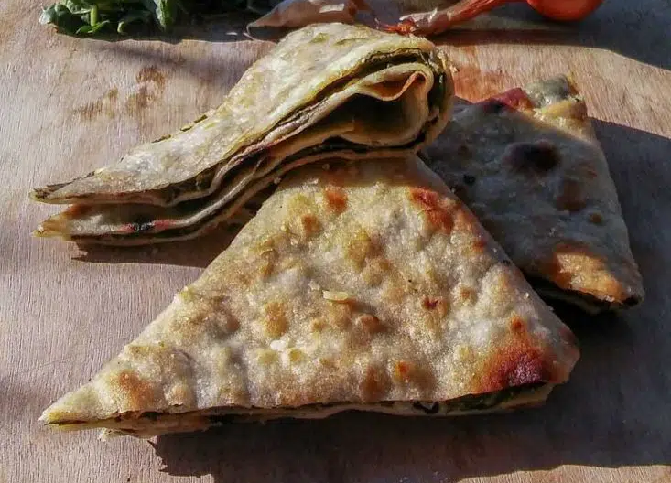
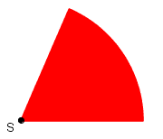
POLJIČKI SOPARNIK
a dish from Poljica that is on the UNESCO list of protected intangible heritage
this dish has been prepared since the time of the Turks, is from the 15th and 16th centuries
in the shape of a pyramid
it is made in the shape of circle and cut in pieces which are circular clips

Slide 6
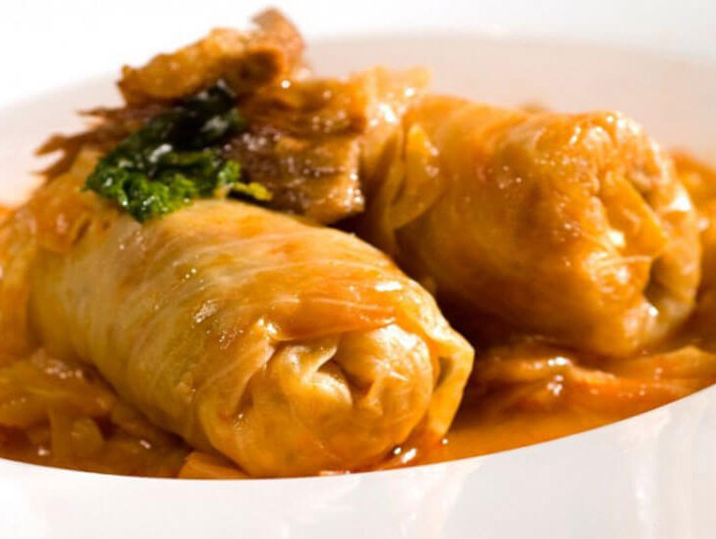
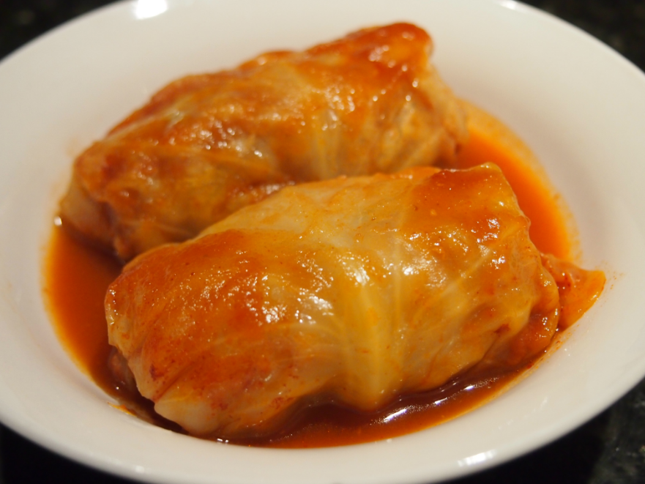
SARMA
sarma is a dish consisting of boiled cabbage leaves wrapped around various fillings
it is common to the cuisines of Central, Northern, Eastern and Southeastern Europe and much of western Asia, northern China, and parts of North Africa
it is done in the form of a cylinder

Slide 7
Literature
https://en.wikipedia.org/wiki/Sarma_(food)
https://hr.wikipedia.org/wiki/Soparnik
https://hr.wikipedia.org/wiki/Hrvatska_kuhinja
https://en.wikipedia.org/wiki/Knedle

Slide 8
THE END
Made by:
Jakov, 8th grade, Elementary School Pušća, Croatia
Mentored by:
Marijana Pili, Math teacher, Elementary School Pušća, Croatia

