Slide 1
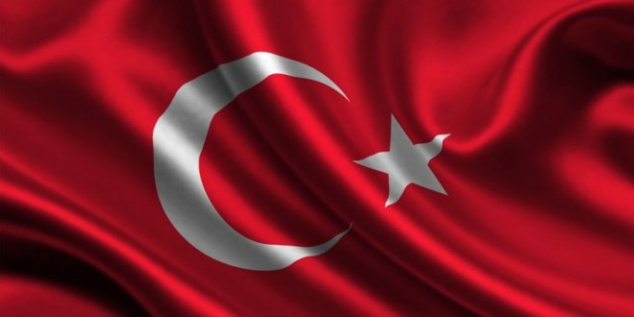

Slide 2
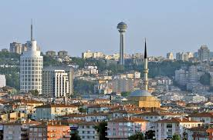
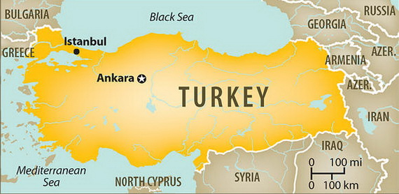
REPUBLIC OF TURKEY
Capital city: Ankara
Population: 73 722 988
Language: Turkish
Turkey is located on Asia and Europe

Slide 3
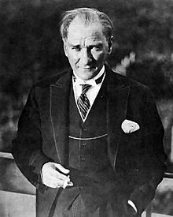
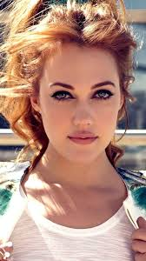
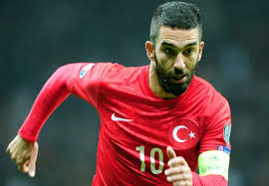
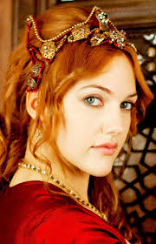
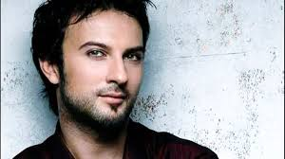
FAMOUS PEOPLE
Mustafa Kemal Atatürk – the Turkish military commander,popular leader and founder of the Turkish Republic and its first president
Meryem Uzerli – Meryem is a Turkish actress of German origin. She is 32 years old. She starred in the series of Suleiman the Magnificent
Arda Turan – he is a football player, he plays for FC Barcelona
Tarkan Tevetoğlu – famous Turkish pop singer, he is 42 years old

Slide 4
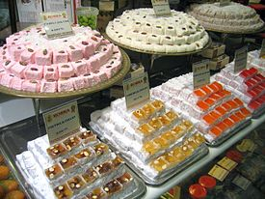
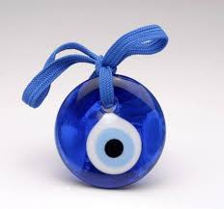
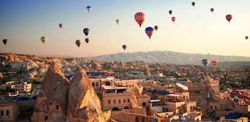
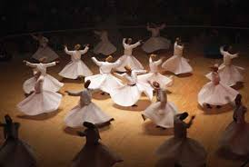
TRADITION,FOOD, SYMBOL AND CULTURE
Turkish Delight (Lokum) –Lokum was intorduced to Western Europe in the 19th century
NAZAR BONCU (Amulet) - The nazar image was used as a symbol on the tailfins of aeroplanes belonging to the private Turkish airline Fly Air.
KAPADOCIA – Ballooning is famous in Kapadocia
DERVISH – Dervishes are people of the Islamic religion; they have an ascetic lifestyle and a special kind of worship of God

Slide 5
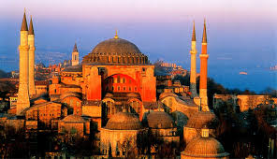
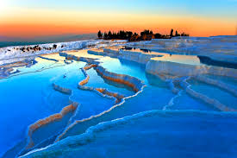
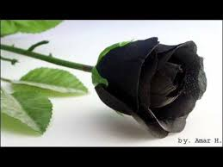
SIGHTS AND NATURE
HAGIA SOPHIA – Is a Turkish mosque. It was finished in 415. It was destroyed by fire,but then the emperor had it built again
PAMUKKALE – Pamukkale is a complex of unique mineral springs in Southwestern Turkey. Pamukkale was registered as a UNESCO’s World Heritag Site in 1988.
BLACK ROSE - Black roses grow only in the Turkish village of Halfeti. They are completely black , and it's their natural color.

Slide 6
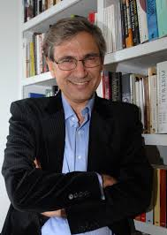
- ORHAN PAMUK
„HAPPINES IS HOLDING SOMEONE IN YOUR ARMS AND KNOWING YOU HOLD THE WHOLE WORLD!”

