Slide 1
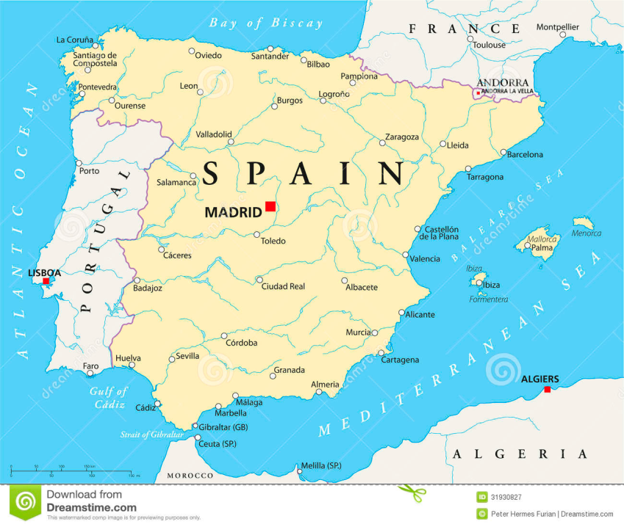
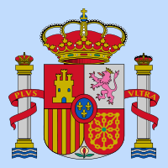
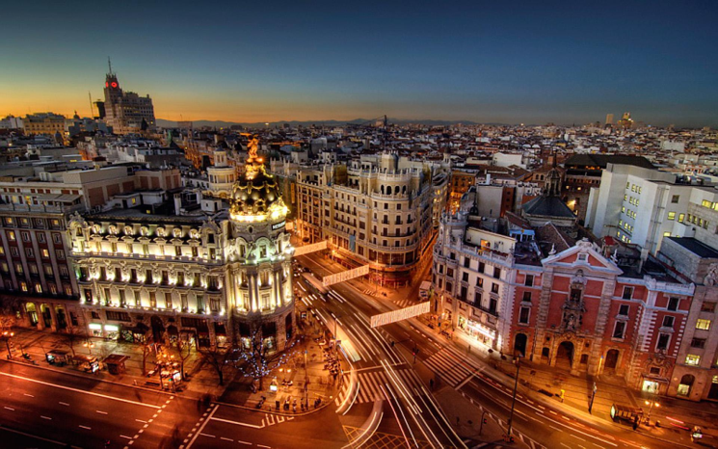
KINGDOM OF SPAIN
It’s located on the Iberian Peninsula in Southwestern Europe.
It has about 46 milion residents.
The capital city is Madrid, it has 3 milion residents.
It’s one of the three countries to have both Atlantic and Mediterranian coastlines.
The king is Felipe VI.

Slide 2
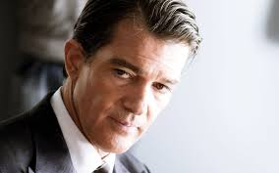
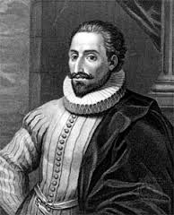
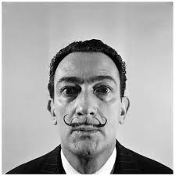
FAMOUS PERSONS
Miguel de Cervantes Saavedra- one of the most famous writers
Salvador Dali- painter, writer, designer and movie author
Antonio Banderas-singer, actor, producer and director

Slide 3
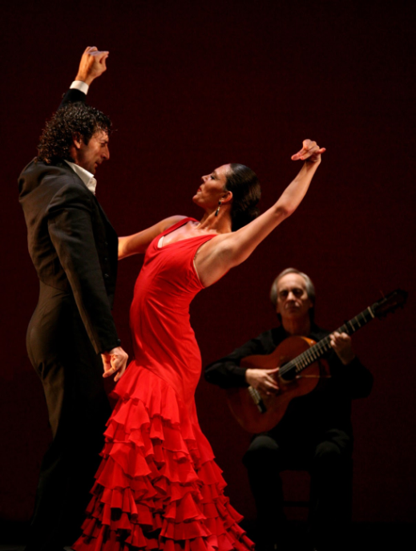
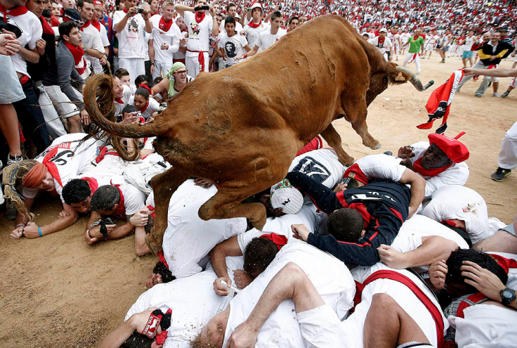
TRADITION AND CULTURE
Spanish music is often considered abroad to be synonymous with flamenco, a genre of music and dance native to the Southern Spanish regions of Andalusia, Extrematura and Murcia
Spain’s National Day is 12th October
One of the most famous festivals is San Fermin in Pamplona, it’s the most famous event is the Encierro, or the running of the bulls which happens from 7th to 14th July

Slide 4
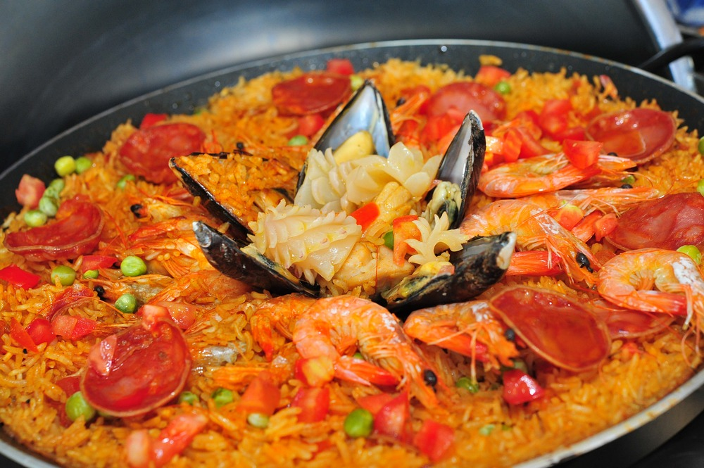
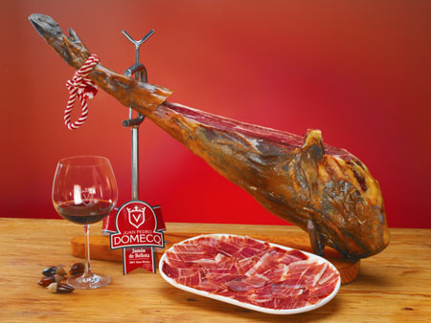
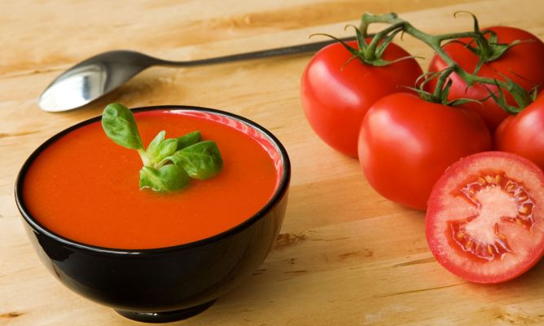
FOOD
PAELLA
JAMON IBERICO
GAZPACHO

Slide 5
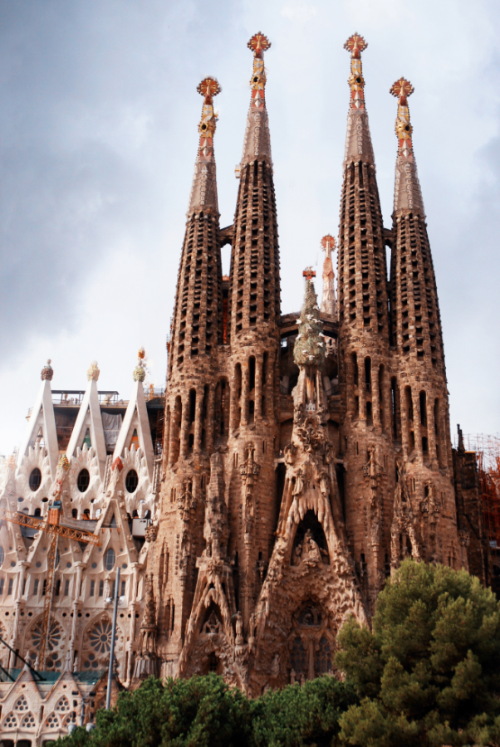
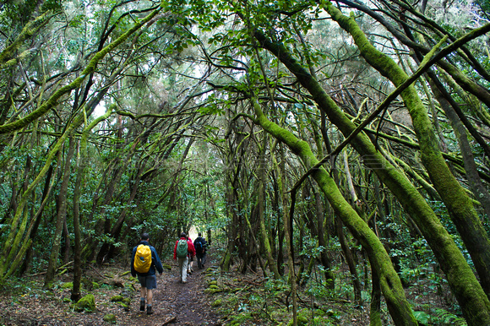
SIGHTS AND NATURE
GARAJONAY NATIONAL PARK
It’s on the island of La Gomera. The park is named after the rock formation of Garajonay, the highest point on the island at 1,487 m (4,869 feet).
ALHAMBRA-GRANADA (13th-14th century)
One of the most beautiful examples of Islamic architecture.
SAGRADA FAMILIA BARCELONA
Construction began in the 19th century, and it still hasn’t finished.
It’s made by combining Gothic and curvilinear art.

Slide 6
-Miguel de Cervantes Saavedra

