Slide 1
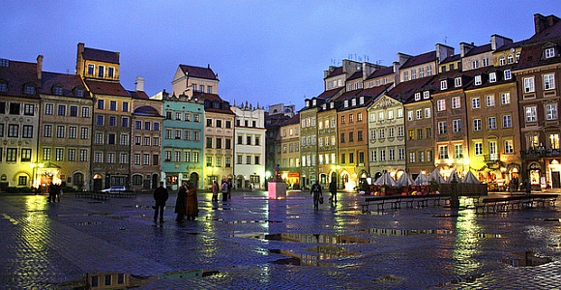
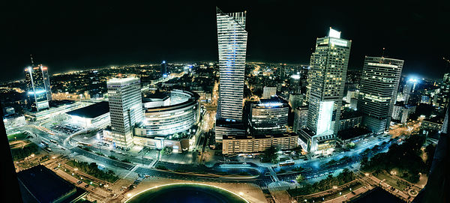
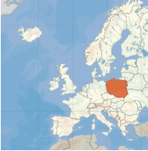
Poland
Warsaw- capital city of Poland
Poland has 38,350,000 people

Slide 2
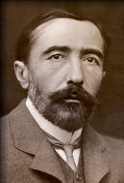
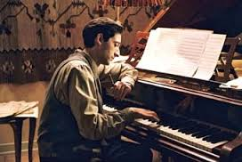
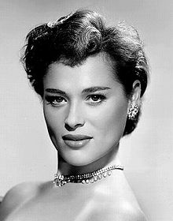
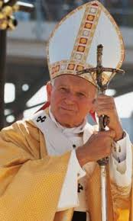
Famous Poles
Władysław “Władek” Szpilman – was a famous Polish pianist and composer
Jozef Teodor Konrad Korzeniowski- was a Polish writer
Karol Józef Wojtyła ( Ivan Pavao 2.)- was a pope from Poland
Bajla Węgier (Bella Darvi)- was a Polish actress

Slide 3
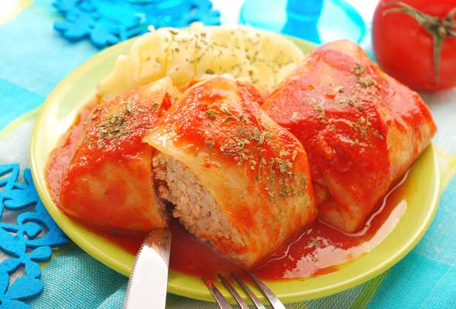
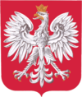
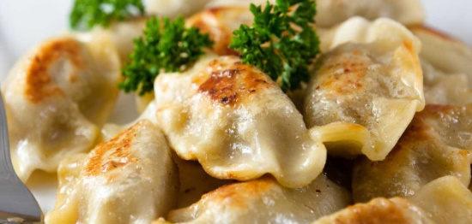
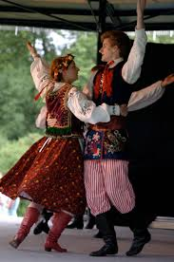
Tradition and culture, food and a symbol of Poland
Polish symbol: Polish emblem
Tradicional Polish food: - golabki
- twaroga
- makowiec
- pierogi
Tradition and culture: traditional Polish dances - zbojnicki
- polka
- krakowiak
- mazur
- polonez
- oberek
- kujawiak

Slide 4
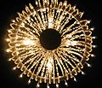
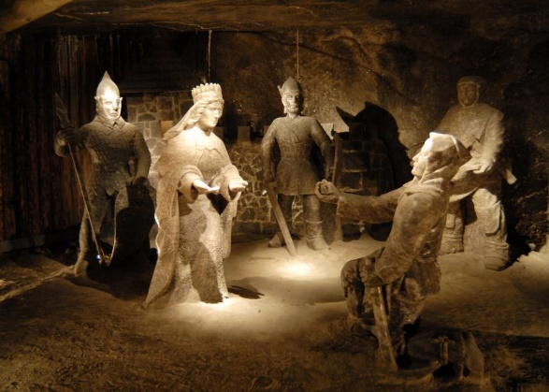
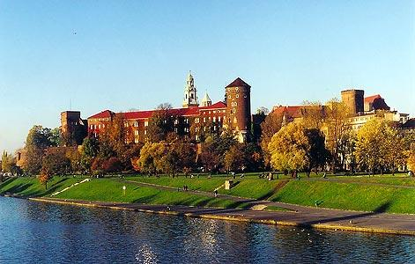
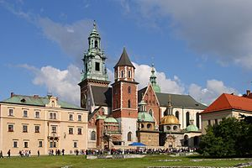
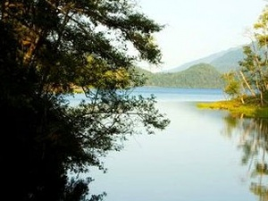
Polish sights
Wawels Cathedral, and castle- on UNESCO’S List of attractions
Old salt mine Wieliczka- is on UNESCO’S List of attractions
Mazurija lake

Slide 5
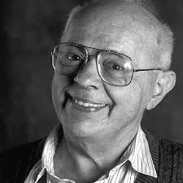
„A dream will always triumph over reality , once it is given the chance”.
Stanislaw Lem

