Slide 1
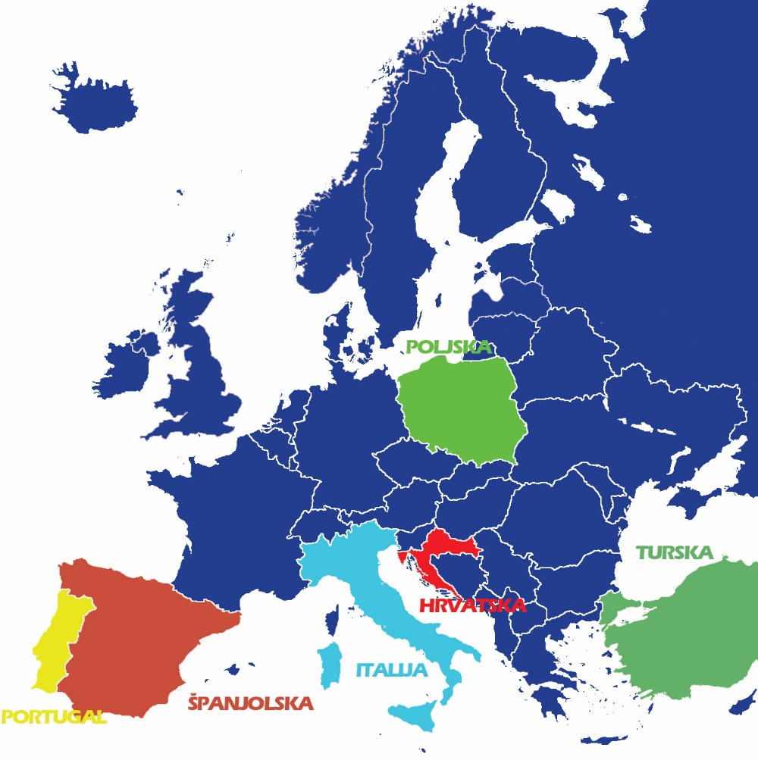
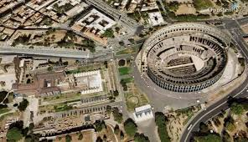
Italy
Italy
capital city - Rome
The population of Italy is estimated
at 61 070 224 as of July 1st 2014.

Slide 2
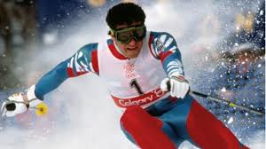
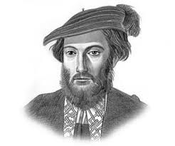
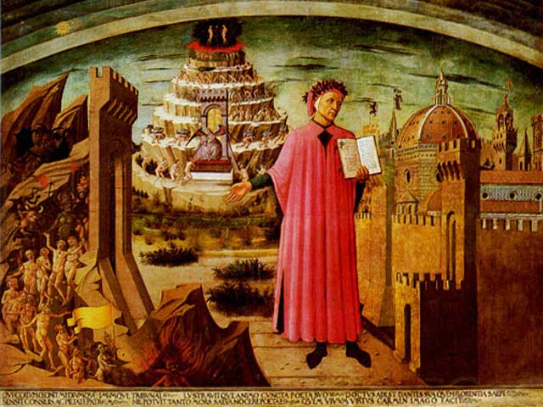
Famous people from Italy
Alberto Tomba
World Cup alpine ski racer from Italy
Dante - Poet, writer, political thinker. Dante was a Medieval Italian poet and philosopher whose poetic trilogy, The Divine Comedy, made an indelible impression on both literature and theology.
America was named after Amerigo Vespucci, a Florentine navigator and explorer who played a prominent role in exploring the New World.

Slide 3
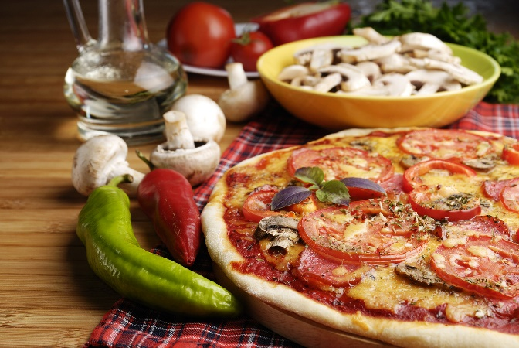
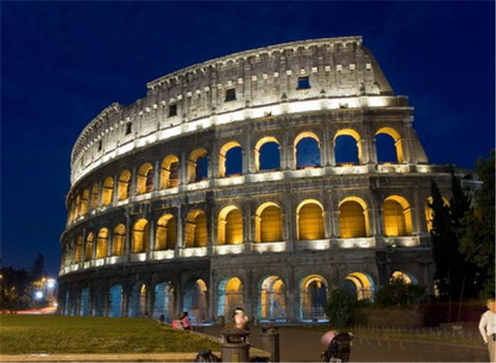
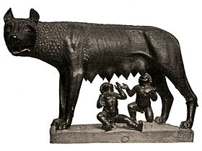
Tradition, food , symbols and culture
FOOD
Italian food does not consist of only pizza and spaghetti, and the menu is as varied as the Italian regions. Italians use a variety of vegetables, such as tomatoes, eggplants, onions, garlic, peas, pepper in their kitchen . Italian food and wine are well known in Canada and North America
CULTURE AND TRADITION
Italy is known for its art, culture and numerous monuments, good food, wine, design, opera and many other things.They eat pasta, Mediterranean kitchen and
have a lot of cheese. Their families stick really closely.
SYMBOLS

Slide 4
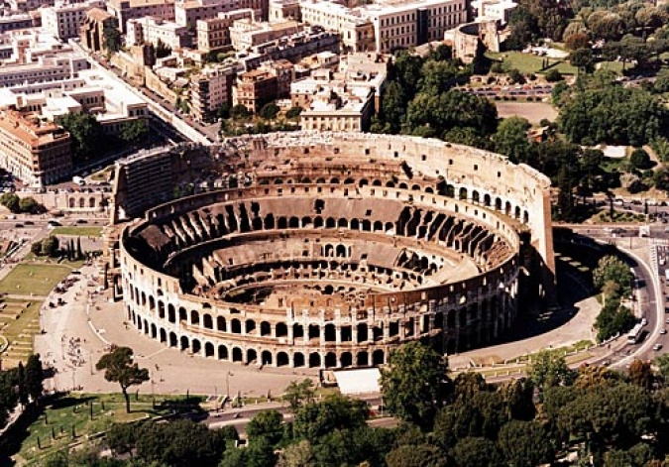
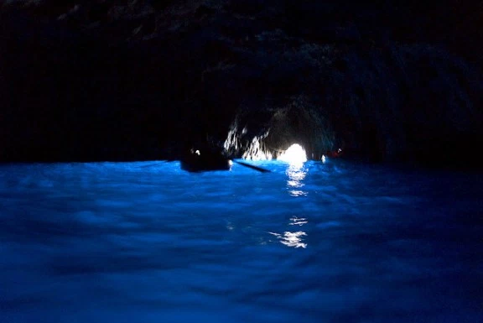
National treasures
Italy is home to the greatest number of UNESCO World Heritage Sites in the world. High art and monuments are to be found everywhere around the country.
Roman Colosseum
it’s one of the most famous sights in all of Italy.It was used for games and spectacles for almost 500 years.
The Blue Grotto Sea Cave: This is a famous sea cave on the coast of the island of Capri, Italy. When the sunlight passess and shines through the water, it creates a blue light that illuminates the cave.

